Slide 1
Lecture6 MIPS ISA
Computer Organization and Architecture

Slide 2
Outline
Register and Memory Organization of MIPS
Typical Instructions
Machine Language
Programming with MIPS instructions
Loop
Call-return
Parallel Synchronous
Compiling
CISC vs RISC

Slide 3
Register Organization
1
32 general purpose registers:r0-r31
A 64-bit Register for Multiply and divide
A 32-bit Register for the program address
PC
Notes:
MIPS register conventions. Register 1, called $at, is reserved for the assembler (see Section 2.12), and registers 26–27, called $k0–$k1, are reserved for the operating system. is information is also found in Column 2 of the MIPS Reference Data Card at the front of this book.

Slide 4
Memory Organization
The space allocated on stack by a procedure is termed the activation record (includes saved values and data local to the procedure) – frame pointer points to the start of the record and stack pointer points to the end – variable addresses are specified relative to $fp as $sp may change during the execution of the procedure
$gp points to area in memory that saves global variables
Dynamically allocated storage (with malloc()) is placed on the heap
$sp --> 7fff fffchex
$gp -->1000 8000hex
1000 0000hex
pc -->0040 0000hex
0
Stack
Dynamic data (heap)
Static data (globals)
Text (instructions)
Reserved
Notes:
The MIPS memory allocation for program and data. These addresses are only a software convention, and not part of the MIPS architecture. The stack pointer is initialized to 7fff fffc_{hex} and grows down toward the data segment. At the other end, the program code (“text”) starts at 0040 0000_{hex}. The static data starts at 1000 0000_{hex}. Dynamic data, allocated by malloc in C and by new in Java, is next. It grows up toward the stack in an area called the heap. e global pointer, $gp, is set to an address to make it easy to access data. It is initialized to 1000 8000_{hex} so that it can access from 1000 0000_{hex} to 1000 ffff_{hex} using the positive and negative 16-bit o sets from $gp. is information is also found in Column 4 of the MIPS Reference Data Card at the front of this book.

Slide 5
Recap: MISP ISA
Arithmetic
Data Transfer
Logical
Conditional Branch
Unconditional Jump

Slide 6
Another Category
2
Arithmetic Instructions
Load/Store Instructions
Logical Instructions
Comparison Instructions
Branch Instructions
Jump Instructions
Other Instructions

Slide 7
Recap: Instruction Format
OPCOD
OPERAND
…
OPERAND
The OPCOD defines the operation of the instruction, such as addition, subtraction, data transfer, etc.
The OPERANDs designate the operate object of the OPCOD, which are the index of the register file, the address of memory, etc.
Both the OPCOD and OPERAND are represented in binary.

Slide 8
Arithmetic Instructions
2.1
add rd, rs, rt
addu rd, rs, rt
addi rt, rs, imm
addiu rt, rs, imm
sub rd, rs, rt
subu rd, rs, rt
mult rs, rt
multu rs, rt
mul rd, rs, rt #put the low-order 32 bits of #the product into the #register rd
div rs, rt
divu rs, rt
mfhi rd #rd<-hi
mflo rd #rd<-lo
mthi rs #hi<-rs
mtlo rs #lo<-rs
Notes:
mfhi: move from hi, move data from hi register
mflo: move from lo, move data from lo register
mthi: move to hi
mtlo: move to lo

Slide 9
Quiz
g= h + A[9]
All variables are int
h stored in $S1, g in $S2, a[0] address in $S3
Correct or Wrong? and Why?
add $S2, $S1, 9($S3)
R-type Instruction in MIPS has no field for immediate value
Notes:
This example explicitly reflect the relationship between instruction functionality and instruction length or instruction format. A fix instruction size and less format describe less functions.

Slide 10
Arithmetic Instructions
madd rs,st #(Hi,Lo)<-(rs X rt)+(Hi,Lo)
maddu rs,rt #(Hi,Lo)<-(rs X rt)+(Hi,Lo)
msub rs, rt #(Hi,Lo)<-(rs X rt)-(Hi,Lo)
msubu rs, rt #(Hi,Lo)<-(rs X rt)-(Hi,Lo)
clo rd,rs
clz rd,rs
#Count the number of leading ones # (zeros) in the word in the register rs #and put the result into register rd. If a #word is all ones (zeros), #the result is #32
Notes:
clo: count leading one
clz: count leading zero

Slide 11
Logical Instructions
and rd, rs, rt
andi rt, rs, imm
or rd, rs, rt
ori rt, rs, imm
xor rd, rs, rt
xori rt, rs, imm
nor rd, rs, rt
sll rd, rt, shamt
sllv rd, rt, rs
sra rd, rt, shamt
srav rd, rt, rs
srl rd, rt, shamt
srlv rd, rt, rs
left
arithmetic
Logical
right

Slide 12
MIPS Logical Instructions
Instruction Example Meaning Comment
and and $1,$2,$3 $1 = $2 & $3 3 reg. operands; Logical AND
or or $1,$2,$3 $1 = $2 | $3 3 reg. operands; Logical OR
xor xor $1,$2,$3 $1 = $2 ⊕ $3 3 reg. operands; Logical XOR
nor nor $1,$2,$3 $1 = ~($2 |$3) 3 reg. operands; Logical NOR
and immediate andi $1,$2,10 $1 = $2 & 10 Logical AND reg, constant
or immediate ori $1,$2,10 $1 = $2 | 10 Logical OR reg, constant
xor immediate xori $1, $2,10 $1 = ~$2 &~10 Logical XOR reg, constant
shift left logical sll $1,$2,10 $1 = $2 << 10 Shift left by constant
shift right logical srl $1,$2,10 $1 = $2 >> 10 Shift right by constant
shift right arithm. sra $1,$2,10 $1 = $2 >> 10 Shift right (sign extend)
shift left logical sllv $1,$2,$3 $1 = $2 << $3 Shift left by variable
shift right logical srlv $1,$2, $3 $1 = $2 >> $3 Shift right by variable
shift right arithm. srav $1,$2, $3 $1 = $2 >> $3 Shift right arith. by variable
Notes:
Multiplication can also be implemented by shift operation. Such like the $s1=$s1*4, sll $s1, $s1, 2
And it is to be noted that there a format difference between shift left by variable and shift by constant. By constant:
sra rd, rt, shamt
That means the shamt field contains constant.
By variable:
srav rd, rt, rs
The shamt field is empty.

Slide 13
Load/Store Instructions
lub rt, address、
lui rt,imm
lh rt, address
lhu rt, address
lw rt, address
lwcl ft, address
lwl rt, address
lwr rt, address
ll rt, address
sb rt, address
sh rt, address
sw rt, address
swc1 ft, address
sdc1 ft, address
swl rt, address
swr rt, address
sc rt, address
double
Condition Flag of Float point Coprocessor
Load Linked
Store Conditional

Slide 14
Comparison Instructions
slt rd, rs, rt
sltu rd, rs, rt
slti rt, rs, imm
sltiu rt, rs, imm
#Set rd if rs less than rt, otherwise clear rd
#Set rt if rs less than imm, otherwise clear rt

Slide 15
Branch Instructions
beq rs, rt, label
bne rs, rt, label
bgez rs, label
bgtz rs, label
blez rs, label
bltz rs, label
bgezal rs, label #in addition to conditional branch,
bltzal rs,label #store the NPC (PC+4) into $ra (r31)

Slide 16
Jump Instructions
j target
jal target #in addition to jump, store the NPC(PC+4) to
# $ra (r31)
jalr rs, rd #jump to the instruction whose
#address is in rs, save NPC in ra(which defaults to 31)
jr rs #jump to the instruction whose address is
# in register rs
Notes:
课堂派选择题: which one has longer jump distance branch instruction beq or Jump instruction jal

Slide 17

Other Instructions
break
syscall
coprocessor instrs.
TLB instrs.
restore from exception
load word left/right
store word left/right
A breakpoint trap occurs, transfers control to exception handler
A system trap occurs, transfers control to exception handler
Support for floating point: discussed later
Support for virtual memory: discussed later
Restores previous interrupt mask & kernel/user mode bits into status register
Supports misaligned word loads
Supports misaligned word stores

Slide 18
Pseudoinstruction
abs rdest, rsrc
div rdest, rsrc1, rsrc2
divu rdest, rsrc1, rsrc2
mulo rdest, rsrc1, rsrc2
mulo rdest, rsrc1, rsrc2
neg rdest, rsrc
negu rdest, rsrc
not rdest, rsrc
rem rdest, rsrc1, rsrc2
remu rdest, rsrc1, rsrc2
rol rdest, rsrc1, rsrc2
ror rdest, rsrc1, rsrc2
li rdest, imm
sd rsrc, address
ush rsrc, address
usw rsrc, address
b label
beqz rsrc, label
bge rsrc1, rsrc2, label
bgeu rsrc1, rsrc2, label
bgt rsrc1, rsrc2, label
bgtu rsrc1, rsrc2, label
ble rsrc1, rsrc2, label
bleu rsrc1, rsrc2, label
blt rsrc1, rsrc2, label
bltu rsrc1, rsrc2, label
bnez rsrc. label
Notes:
MARS举例：位指令 li $t1, 100和li $t1, 10000000
Pseudoinstruction means "fake instruction". You might wonder why they exist. When designing a modern ISA, one criteria is to decide whether an instruction should be part of the ISA or not. In the past, if you could see a use for the instruction, it was often added to ther instruction set. This lead to bloated and slow implementations.In the 1980s, researcher began questioning the assumptions of how to design an ISA. The original thinking was to write ISAs that would be compact and useful to compiler writers. Compactness was important because memory was very expensive up until the 1980's.
Thus, instructions were often variable-sized, i.e., some instructions had as few as one byte, to as many as, say, 8 or more bytes. The thinking was "why use any more bytes than necessary".
Once memory became cheaper, it was reasonable to think that perhaps instruction sizes could be larger, and perhaps fixed in size. This would allow hardware designers to use advanced techniques like pipelining. By having equal sized instructions, it was easier to fetch the instructions, because no decoding was required.
Initially, RISC ISA designers thought that minimizing the total number of instructions was the best way to go. Fewer instructions meant simpler hardware, and simpler hardware meant easier optimization.
Fewer instructions also meant larger volume of code. What used to be executed in one CISC instruction might require ten or more RISC instructions. The hope was that faster hardware (and caches) would offset the increase in code size.
This turned out not to be the case. It was decided that the best way to decide whether an instruction should or should not be included was benchmarking. Use typical C or FORTRAN code, and compile it to assembly. Run the code on a CPU, and see if the time to execute runs significantly faster with the instruction as opposed to without. If it performs better, leave the instruction in. If not, leave it out.
This idea was fairly revolutionary. Instead of designing for compiler writers and memory, the idea was to design ISAs for performance.
However, by taking out some instructions, assembly language programmers would find it a little harder to write code. To make it easier for them, pseudoinstructions were added. Pseudoinstructions do not correspond to real MIPS instructions.
Instead, the assembler, a program that converts assembly language programs to machine code, would then translate pseudoinstructions to real instructions, usually requiring at least one on more instructions.
Pseudoinstructions not only make it easier to program, it can also add clarity to the program, by making the intention of the programmer more clear.
As mentioned above, the MIPS hardware makes sure that register $zero always has the value 0. at is, whenever register $zero is used, it supplies a 0, and the programmer cannot change the value of register $zero. Register $zero is used to create the assembly language instruction that copies the contents of one register to another. us the MIPS assembler accepts this instruction even though it is not found in the MIPS architecture:
move $t0,$t1 # register $t0 gets register $t1
e assembler converts this assembly language instruction into the machine language equivalent of the following instruction:
add $t0,$zero,$t1 # register $t0 gets 0 + register $t1

Slide 19
3
Machine Language-Instruction Format

Slide 20
Machine Language – Instruction Format
3

Slide 21
Machine Language-(R-Type)
3.1
Instructions, like registers and words of data, are 32 bits long
Arithmetic Instruction Format (R format):
add
$t0
$s1
$S2
“add” can be replaced by other operations, such as sub, and, sllv, …
op rs rt rd shamt funct
6
5
5
5
op 6-bits opcode that specifies the operation
rs 5-bits register file address of the first source operand
rt 5-bits register file address of the second source operand
rd 5-bits register file address of the result’s destination
shamt 5-bits shift amount (for shift instructions)
funct 6-bits function code augmenting the opcode add

Slide 22
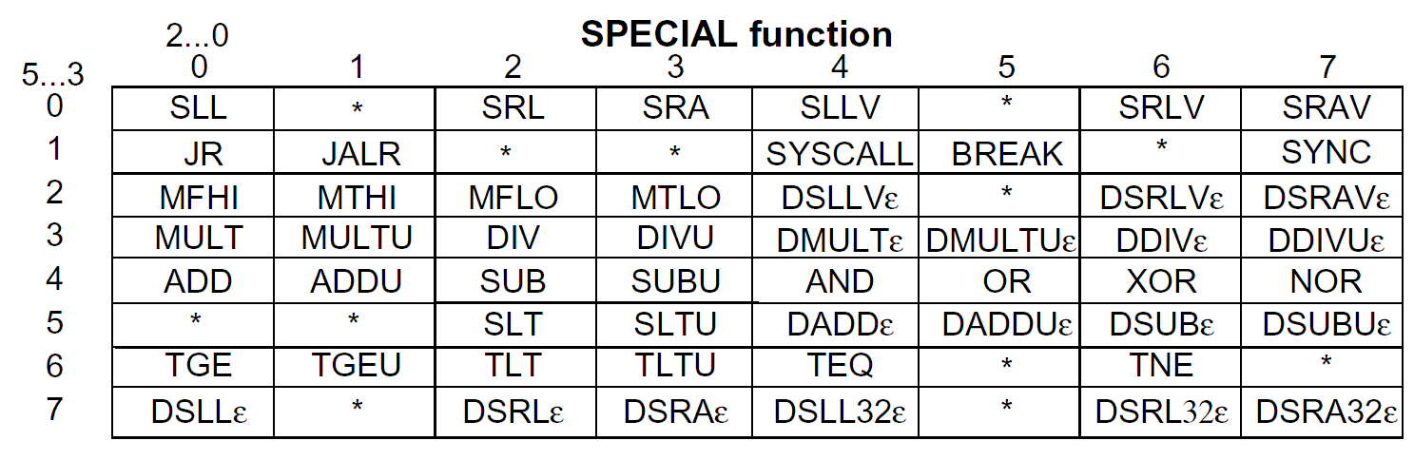
R-Type Encoding
[MIPS R4000 Microprocessor User’s Manual]

Slide 23
R-Type Encoding

Slide 24
R-Type Encoding

Slide 25
Machine Language - (I-Type)
3.2
Load/Store Instruction Format (I format):
lw
$t0
24
$s2
“lw” can be replaced by other operations, such as st, bnz, ori, et. al.
op rs rt 16 bit offset
Memory
24₁₀ + $s2 =
0x120040ac
0xf f f f f f f f
$t0
0x120040ac
$s2
0x12004094
0x0000000c
0x00000008
0x00000004
0x00000000
data
word address (hex)

Slide 26
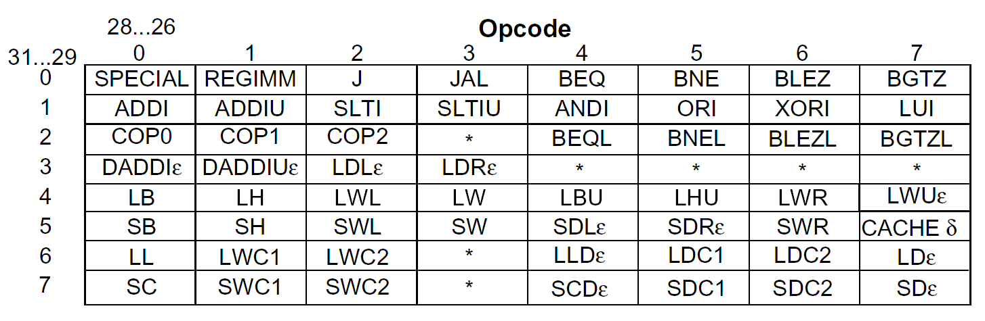
Reg-Immed Instruction Encoding
[MIPS R4000 Microprocessor User’s Manual]

Slide 27
Machine Language - (J-Type)
3.3
op
6
Label
from the low order 26 bits of the jump instruction
26
00
32
4
PC

Slide 28
MIPS Operand Addressing Modes
Register addressing – operand is in a register
op rs rt rd funct
Register
word operand
Base (displacement) addressing – operand is at the memory location whose address is the sum of a register and a 16-bit constant contained within the instruction
op rs rt offset
Memory
word or byte operand
base register
Register relative (indirect) with 0($a0)
Pseudo-direct with addr($zero)
Immediate addressing – operand is a 16-bit constant contained within the instruction
op rs rt operand

Slide 29
MIPS Operand Addressing Modes
PC-relative addressing –instruction address is the sum of the PC and a 16-bit constant contained within the instruction
Pseudo-direct addressing – instruction address is the 26-bit constant contained within the instruction concatenated with the upper 4 bits of the PC
op rs rt offset
Memory
branch destination instruction
Program Counter (PC)
op jump address
Memory
|
|
jump destination instruction
Program Counter (PC)

Slide 30
Programming with MIPS Instruction
4
Arithmetic and logical operation
Use the corresponding arithmetic/logical instruction directly, if all the operands are in the registers (source operand can be immediate data).
If the source operand is located in memory, it should be moved into register by ‘lw’ before computing.
If the destination operand is a memory operand, it should be transferred to memory use ‘st’ instruction after computing.
Some examples…

Slide 31
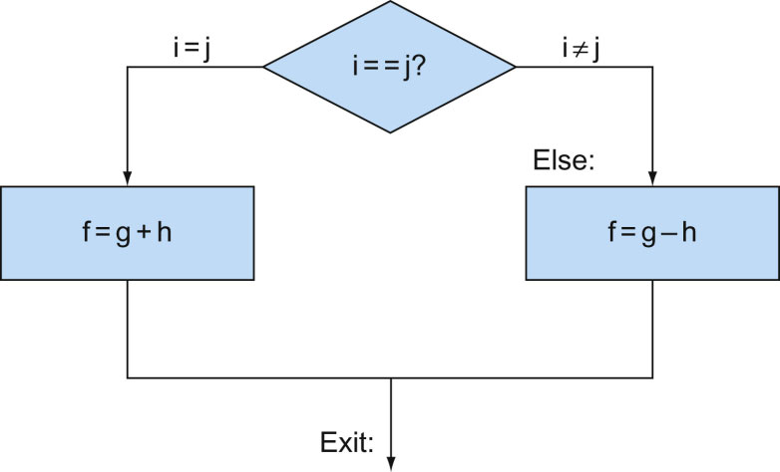
Programming with MIPS Instruction
4.1
if (i==j)
f=g+h;
else
f=g-h;
Suppose the 5 variables are in the register as follows:
i:$s0, j:$s1, f:$s2, g: $s3, h:$s4
Notes:
https://godbolt.org/
int cal(int i, int j, int g, int h) {
int f;
if (i==j)
f=g+h;
else
f=g-h;
return f;
}

Slide 32
Programming with MIPS Instruction
Assumption:
The address of A[i]: $s0;
address of A[0]:4
s:$s1;
for (i=1000; i>=0;i--)
A[i]=A[i]+s;
Loop:
lw $s2, 0($s0)
add $s2, $s2, $s1
sw $s2, 0($s0)
subi $s0, $s0, 4
bnez $s0, Loop
Notes:
https://godbolt.org/
int i;
int s;
int A[1000];
void main(void) {
for (i=1000; i>=0;i--)
A[i]=A[i]+s;
}
Branch if not equal to zero.
bnez $rs,Label
bne $rs,$zero,Label #if (R[rs]!=0) PC=Label

Slide 33
Programming-Procedure Call
4.2
Stacking of Subroutine Calls & Returns and Environments:
A:
CALL B
CALL C
C:
RET
RET
A
B:
A
B
A
B
C
A
B
A
Some machines provide a memory stack as part of the architecture
(e.g., VAX)
Sometimes stacks are implemented via software convention (e.g., MIPS)

Slide 34
Programming-Stack
Located in Memory
Implementation
Was supported by ISA, specified instructions, such as push and pop instructions in 80X86
By software, such as in MIPS. $sp, which stores the address of top of the stack, should be updated by the programmer.

Slide 35
Memory Stacks
Useful for stacked environments/subroutine call & return even if
operand stack not part of architecture
Stacks that Grow Up vs. Stacks that Grow Down:
Next
Empty?
inf. Big
0 Little
grows
up
grows
down
Memory
Addresses
c
Last
Full?
b
SP
a
0 Little
inf. Big
How is empty stack represented?
Little --> Big/Last Full
POP: Read from Mem(SP)
Decrement SP
PUSH: Increment SP
Write to Mem(SP)
Little --> Big/Next Empty
POP: Decrement SP
Read from Mem(SP)
PUSH: Write to Mem(SP)
Increment SP

Slide 36
Call-Return Linkage: Stack Frames
FP
High Mem
SP
ARGS
(If Nested)
Reference args and
local variables at
fixed (positive) offset
from FP
SP
Callee Save
Registers
(old FP, RA)
SP
Local Variables
SP
Grows and shrinks during
expression evaluation
Low Mem
Many variations on stacks possible (up/down, last pushed / next )
Compilers normally keep scalar variables in registers, not memory!

Slide 37
Programming-Procedure Call
4.2
Put the parameters in a place where the procedure can access them.
Transfer control to the procedure.
Acquire the storage resources needed for the procedure.
Perform the desired task.
Put the result value in a place where the calling program can access it.
Return the control to the point of origin, since a procedure can be called from several points in a program.

Slide 38
MIPS: Software conventions for Registers
0 zero constant 0
1 at reserved for assembler
2 v0 expression evaluation &
3 v1 function results
4 a0 arguments
5 a1
6 a2
7 a3
8 t0 temporary: caller saves
. . . (callee can clobber)
15 t7
16 s0 callee saves
. . . (callee must save)
23 s7
24 t8 temporary (cont’d)
25 t9
26 k0 reserved for OS kernel
27 k1
28 gp Pointer to global area
29 sp Stack pointer
30 fp frame pointer
31 ra Return Address (HW)

Slide 39
MIPS / GCC Calling Conventions
4.3
FP
fact:
addiu $sp, $sp, -32
sw $ra, 20($sp)
sw $fp, 16($sp)
addiu $fp, $sp, 32
. . .
sw $a0, 0($fp)
...
lw $31, 20($sp)
lw $fp, 16($sp)
addiu $sp, $sp, 32
jr $31
SP
ra
low
address
FP
SP
ra
ra
old FP
FP
SP
ra
old FP
First four arguments passed in registers.

Slide 40
Programming- C example: swap
Assumption:
Swap can be called as a procedure
temp: $15 is clean to be used
Parameters are stored in $a1 and $a2
$16 is used as scratchpad reg

Slide 41
MIPS Instruction: swap
swap: #begin from this label
addi $sp, $sp, -4 #create space on stack
sw $16, 0($sp) #callee saved register put onto #stack
sll $t2, $a2, 2 #multiply k by 4
addu $t2, $a1, $t2 #address of v[k]
lw $15, 0($t2) #load v[k]
lw $16, 4($t2) #load v[k+1]
sw $16, 0($t2) #store v[k+1] into v[k]
sw $15, 4($t2) #store v[k] into v[k+1]
lw $16, 8($sp) #callee saved register restored #from stack
addi $sp, $sp, 4 #restore top of stack
jr $31 #return to place that #called swap

Slide 42
Quiz
Which type of variable that can contain 1,000,000,000_{ten} takes the most memory space?
1. int in C 2. string in C 3. string in Java
Notes:
Java uses Unicode for characters, which , by default, uses 16 bits to represent a character.
String in C is represented with ASCII and a NULL at the end. So the it is n+1 bytes for a n-charactor string.

Slide 43
Pointer and Array
4.4
Array Version Clear
Pointer Version
clear1(int array[], int size)
{ int i;
for (i = 0; i < size; i += 1)
array[i] = 0;
}
clear2(int *array, int size) { int *p;
for (p = &array[0]; p < &array[size]; p = p + 1)
*p = 0;
}
The pointer version moves the scaling shift and the array bound addition outside the loop, thereby reducing the instructions executed per iteration from 6 to 4.

Slide 44
Pointer and Array
Array Version Clear
Pointer Version
clear1(int array[], int size)
{ int i;
for (i = 0; i < size; i += 1)
array[i] = 0;
}
clear2(int *array, int size) { int *p;
for (p = &array[0]; p < &array[size]; p = p + 1)
*p = 0;
}
move $t0,$zero #i= 0 loop1: sll $t1,$t0,2 # $t1 = i* 4
add $t2,$a0,$t1 #$t2= address of array[i]
sw $zero, 0($t2) #array[i] = 0
addi $t0,$t0,1 #i=i+ 1 slt $t3,$t0,$a1 # $t3 = (i < size)
bne $t3,$zero,loop1 #if(i<size)gotoloop1

Slide 45
Pointer and Array
Pointer Version
clear2(int *array, int size) { int *p;
for (p = &array[0]; p < &array[size]; p = p + 1)
*p = 0;
}
move $t0,$a0 # p = address of array[0]
sll $t1,$a1,2 # $t1 = size * 4
add $t2,$a0,$t1 # $t2 = address of array[size]
loop2: sw $zero,0($t0) # Memory[p] = 0
addi $t0,$t0,4 # p = p + 4
slt $t3,$t0,$t2 # $t3 = (p<&array[size])
bne $t3,$zero,loop2 # if (p<&array[size]) go to loop2

Slide 46
Compiler, Assembler, and Linker
4.5
Why DLL? And how DLL works ?
Notes:
A translation hierarchy for C. A high-level language program is first compiled into an assembly language program and then assembled into an object module in machine language. The linker combines multiple modules with library routines to resolve all references. The loader then places the machine code into the proper memory locations for execution by the processor. To speed up the translation process, some steps are skipped or combined. Some compilers produce object modules directly, and some systems use linking loaders that perform the last two steps. To identify the type of file, UNIX follows a suffix convention for files: C source files are named x.c, assembly files are x.s, object files are named x.o, statically linked library routines are x.a, dynamically linked library routes are x.so, and executable files by default are called a.out. MS-DOS uses the suffixes .C, .ASM, .OBJ, .LIB, .DLL, and .EXE to the same effect.
Static library disadvantages:
Fixed executable code, hard to update the lib
Huge code size 2.5MB standard C lib
These disadvantages lead to dynamically linked libraries (DLLs), where the library routines are not linked and loaded until the program is run. Both the program and library routines keep extra information on the location of nonlocal procedures and their names. In the initial version of DLLs, the loader ran a dynamic linker, using the extra information in the le to find the appropriate libraries and to update all external references.
Like many innovations in our field, this trick relies on a level of indirection. PH. Figure 2.22 shows the technique. It starts with the nonlocal routines calling a set of dummy routines at the end of the program, with one entry per nonlocal routine. ese dummy entries each contain an indirect jump. The first time the library routine is called, the program calls the dummy entry and follows the indirect jump. It points to code that puts a number in a register to identify the desired library routine and then jumps to the dynamic linker/loader. The linker/loader finds the desired routine, remaps it, and changes the address in the indirect jump location to point to that routine. It then jumps to it. When the routine completes, it returns to the original calling site. thereafter, the call to the library routine jumps indirectly to the routine without the extra hops.

Slide 47
Parallelism and Instructions: Synchronization
4.6
If data race happens, communication will fail in parallel threads
If a shared variable S is updated by Thread 1
Meanwhile Thread 2 read S which address in $s1
An atomically synchronization needed
atomic exchange or atomic swap
A lock: 0 for free and 1 for already claimed access
again: addi $t0,$zero,1 # copy locked value
ll $t1,0($s1) # load linked
sc $t0,0($s1) # store conditional
beq $t0,$zero,again # branch if store fails
add $s4,$zero,$t1 # put load value in $s4

Slide 48
CISC vs RISC
5.0
Complex instruction: An instruction does a lot of work, e.g. many operations
Insert in a doubly linked list
Compute FFT
String copy
Simple instruction: An instruction does small amount of work, it is a primitive using which complex operations can be built
Add
XOR
Multiply
Notes:
Advantages of Complex instructions
+ Denser encoding → smaller code size → better memory utilization, saves off-chip bandwidth, better cache hit rate (better packing of instructions)
+ Simpler compiler: no need to optimize small instructions as much
Disadvantages of Complex Instructions
- Larger chunks of work → compiler has less opportunity to optimize (limited in fine-grained optimizations it can do)
- More complex hardware → translation from a high level to control signals and optimization needs to be done by hardware

Slide 49
ISA-level Tradeoffs: Semantic Gap
Where to place the ISA? Semantic gap
Closer to high-level language (HLL) → Small semantic gap, complex instructions
Closer to hardware control signals? → Large semantic gap, simple instructions
RISC vs. CISC machines
RISC: Reduced instruction set computer
CISC: Complex instruction set computer
FFT, QUICKSORT, POLY, FP instructions?
VAX INDEX instruction (array access with bounds checking)
Notes:
The semantic gap characterizes the difference between two descriptions of an object by different linguistic representations, for instance languages or symbols. In computer science, the concept is relevant whenever ordinary human activities, observations, and tasks are transferred into a computational representation.

Slide 50
ISA-level Tradeoffs: Instruction Length
Fixed length: Length of all instructions the same
+ Easier to decode single instruction in hardware
+ Easier to decode multiple instructions concurrently
-- Wasted bits in instructions (Why is this bad?)
-- Harder-to-extend ISA (how to add new instructions?)
Variable length: Length of instructions different (determined by opcode and sub-opcode)
+ Compact encoding (Why is this good?)
Intel 432: Huffman encoding (sort of). 6 to 321 bit instructions. How?
-- More logic to decode a single instruction
-- Harder to decode multiple instructions concurrently
Tradeoffs
Code size (memory space, bandwidth, latency) vs. hardware complexity
ISA extensibility and expressiveness vs. hardware complexity
Performance? Smaller code vs. ease of decode

Slide 51
ISA-level Tradeoffs: Uniform Decode
Uniform decode: Same bits in each instruction correspond to the same meaning
Opcode is always in the same location
Ditto operand specifiers, immediate values, …
Many “RISC” ISAs: Alpha, MIPS, SPARC
+ Easier decode, simpler hardware
+ Enables parallelism: generate target address before knowing the instruction is a branch
-- Restricts instruction format (fewer instructions?) or wastes space
Non-uniform decode
E.g., opcode can be the 1st-7th byte in x86
+ More compact and powerful instruction format
-- More complex decode logic

Slide 52
ISA-level Tradeoffs: Number of Registers
Affects:
Number of bits used for encoding register address
Number of values kept in fast storage (register file)
(uarch) Size, access time, power consumption of register file
Large number of registers:
+ Enables better register allocation (and optimizations) by compiler → fewer saves/restores
-- Larger instruction size
-- Larger register file size

Slide 53
ISA-level Tradeoffs: Addressing Modes
Addressing mode specifies how to obtain an operand of an instruction
Register
Immediate
Memory (displacement, register indirect, indexed, absolute, memory indirect, autoincrement, autodecrement, …)
More modes:
+ help better support programming constructs (arrays, pointer-based accesses)
-- make it harder for the architect to design
-- too many choices for the compiler?
Many ways to do the same thing complicates compiler design
Wulf, “Compilers and Computer Architecture,” IEEE Computer 1981

